Slide 1



1
05
Software
Requirements
z

Slide 2
2
z
Today’s
Lesson
Understanding
Requirements
Requirements
Requirements
Engineering
Modelling
COE 356: Introduction to Software Engineering

Slide 3

3
z
Understanding Requirements

Slide 4
4
z
Requirements Engineering
§ The broad spectrum of tasks and techniques that lead to an
understanding of requirements is called requirements engineering.
§ It begins during the communication activity and continues into
the modeling activity.
§ It must be adapted to the needs of the process, the project, the
product, and the people doing the work

Slide 5
5
z
Requirements Engineering
Requirements engineering provides the
mechanism for:
§ Understanding what the customer wants
§ Analysing need
§ Assessing feasibility
§ Negotiating a reasonable solution
§ Specifying the solution unambiguously
§ Validating the specification
§ Managing the requirements
appropriate

Slide 6
6
z
Requirements
Engineering
It encompasses
seven distinct
tasks:
Inception
Elicitation
Elaboration
Negotiation
Management
Validation
Specification
It is important to note that some of these tasks occur in parallel and
the needs of the project
all are adapted to

Slide 7
7
z
Requirements
Engineering
Inception
§ How does a software project get started?
§ Is there a single event that becomes the catalyst for a new product, or does
the need evolve over time?
§ At project inception the following are established:
§ A basic understanding of the problem
§ The people who want a solution
§ The nature of the solution that is desired
§ The effectiveness of preliminary communication and collaboration

Slide 8
8
z
Requirements
Engineering
Elicitation
§ Ask the customer, the users, and others:
§ What are objectives for the system or product?
§ What is to be accomplished?
§ How does the system or product fit into the needs of the business?
§ How is the system or product to be used on a day-to-day basis?
Problems which may arise:
• Scope
• Understanding
• Volatility

Slide 9
9
z
Elicitation
Work Products
§ A statement of need and feasibility.
§ A bounded statement of scope for the system or product.
§ A list of customers, users, and other stakeholders who participated in
requirements elicitation.
§ A description of the system’s technical environment.
§ A list of requirements
§ A set of usage scenarios under different operating conditions.
§ Any prototypes developed to better define requirements
Read on developing use cases

Slide 10
10
z
Requirements Engineering
Elaboration
§ The information obtained from the customer is expanded and refined.
§ Focuses on developing a refined requirements model that identifies
various aspects of software function, behaviour, and information.
§ Creation of user scenarios
§ Extraction of analysis classes
§ The relationships and collaboration between classes are identified,
and a variety of supplementary diagrams are produced

Slide 11
11
z
Requirements Engineering
Negotiation
§ It isn’t unusual for customers to ask for more than can be achieved
§ It’s also common for customers to propose conflicting requirements
§ Use an iterative approach that prioritizes requirements, assesses
their cost and risk, and addresses internal conflicts
§ Requirements are eliminated, combined, and/or modified so that
each party achieves some measure of satisfaction.

Slide 12
12
z
Requirements
Engineering
Specification
§ A specification can be a written document, a set of graphical
models, a formal mathematical model, a collection of usage
scenarios, a prototype, or any combination of these
§ It may vary depending on project size
§ Usage scenarios may be all that are required for smaller products
or systems that reside within well-understood technical environments

Slide 13
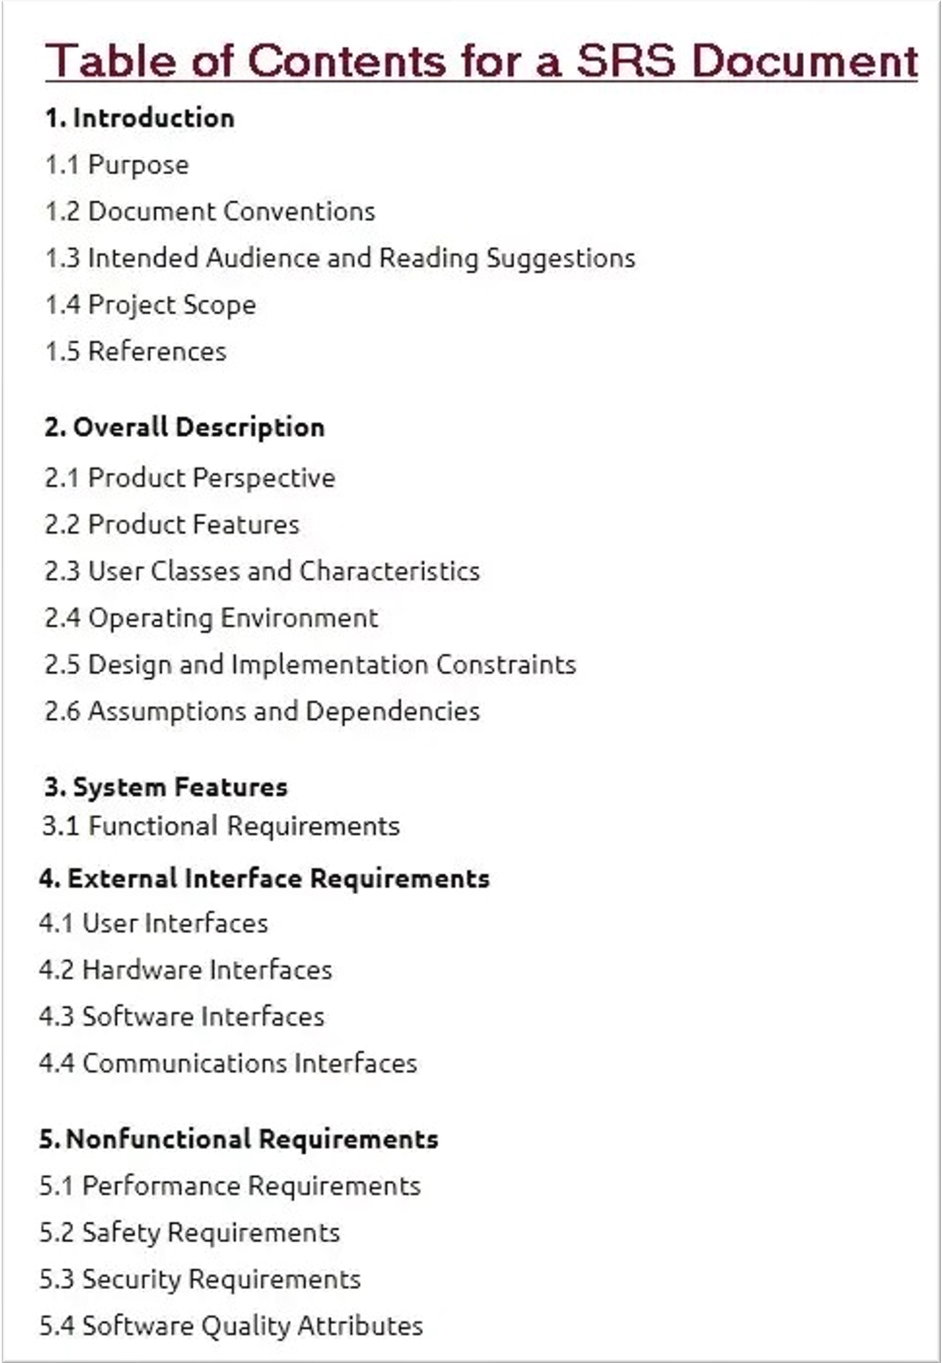
13
z
SRS Document
Software Requirement
Specification Contents Template

Slide 14
14
z
Requirements Engineering
Validation
§ The work products produced as a consequence of requirements
engineering are assessed for quality during a validation step
§ Examine the specification to ensure that:
§ All software requirements have been stated unambiguously
§ Inconsistencies, omissions, and errors have been corrected
§ The work products conform to the standards established for the
process, the project, and the product.

Slide 15
15
z
Requirements Engineering
Requirements Management
§ Requirements for computer-based systems change throughout
the life of the system.
§ Requirements management is a set of activities that help the project team identify, control, and track requirements and changes to requirements at any time as the project proceeds

Slide 16
16
z
Requirement
Modelling
§ Requirements modelling uses a combination of text and
diagrams to depict requirements in a way that is relatively easy to understand, and more important, straightforward to review for correctness, completeness, and consistency

Slide 17
17
z
Requirement Modelling Approaches
Two Approaches
§ Structured Analysis: considers data and the processes that
transform the data as separate entities.
§ Object-Oriented Analysis: focuses on the definition of classes and the manner in which they collaborate with one another to effect customer requirements.

Slide 18
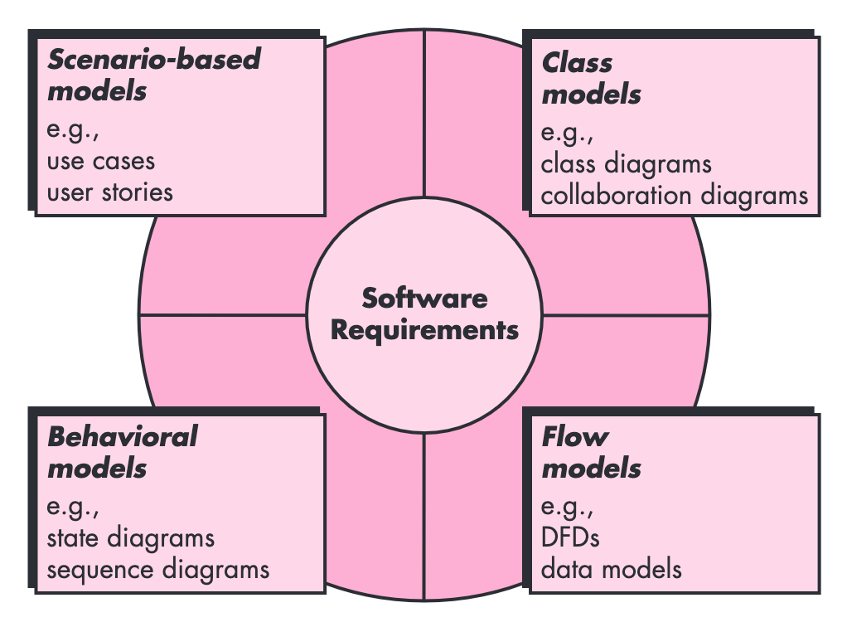
18
z
Requirement
Modelling
Approaches
point of view
O-O classes
(attributes and
operations)
system
“actors”
Functional
elements of the system and how they transform data
How the software
behaves as a consequence of external “events”

Slide 19
19
z
Scenario-based Modelling
USE-CASE DIAGRAMS
§ Primary use is to visualise user or customer interactions with the
system
§ System: Scenario
§ Actors: The users that interact with a system, (person, organization
or external system)
§ Use cases: uses or activities
§ Relationships

Slide 20
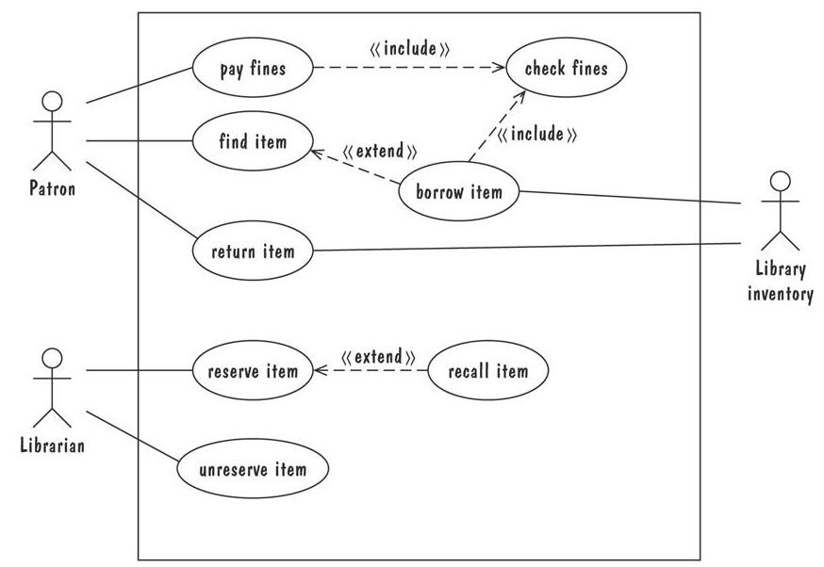
20
z
USE-CASE DIAGRAMS

Slide 21
21
z
Data Modelling
§ If software requirements include the need to create, extend, or
interface with a database or if complex data structures must be constructed and manipulated, the software team may choose to create a data model as part of overall requirements modelling
§ Data Objects
§ Data Attributes
§ Relationships

Slide 22
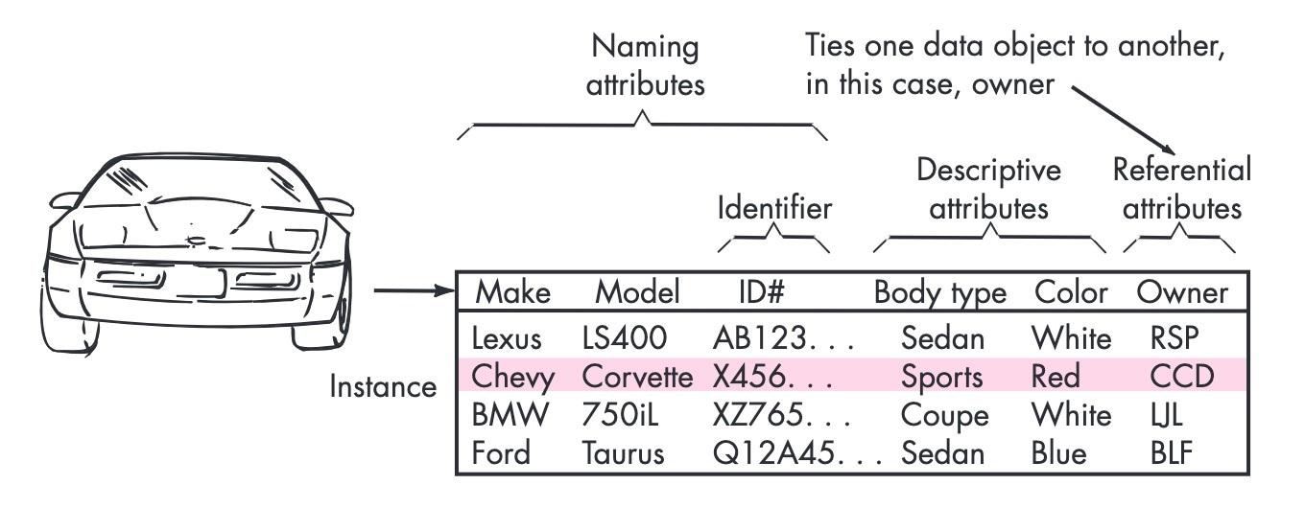
22
z
Data Modelling
Data object and attributes

Slide 23
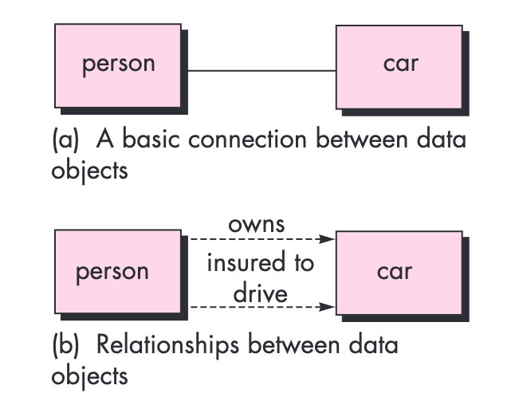
23
z
Data Modelling
Relationships

Slide 24
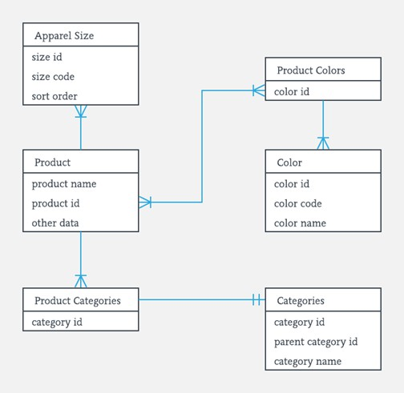
24
z
Data
Modelling
Entity-Relationship Diagram
§ The object-relationship pair
can also be represented
graphically using the entity-
relationship diagram
(ERD).
§ The ERD was originally
proposed by Peter Chen
for the design of relational
database systems

Slide 25
25
z
Class-based
Modelling
§ Class-based modelling represents the:
§ Objects that the system will manipulate
§ Operations that will be applied to the objects
§ Relationships between the objects
§ Collaborations that occur between the classes

Slide 26
26
z
Categories
of
classes
Entity Classes
• Represent system data - Models
Boundary Classes
• Interface with system actors - User/External
Service
Controller Classes
• Mediate between entities and boundaries – Manage processes

Slide 27
27
z
Identifying Classes
Rules for class communications
Entity Boundary Controller Actor
Entity
X X
Boundary
X X
Controller
X X X
Actor
X

Slide 28
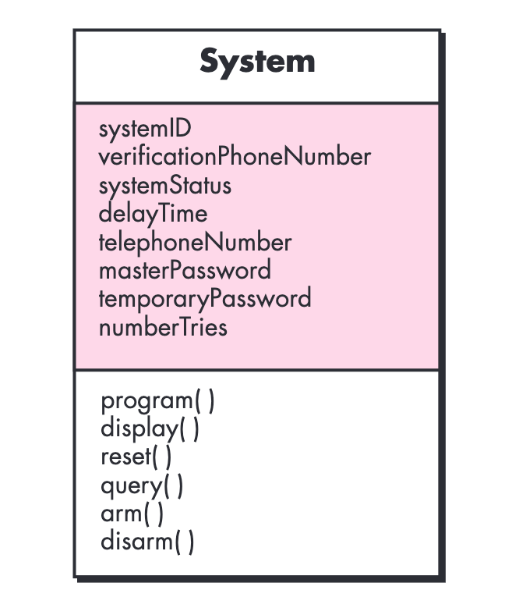
28
z
Class-based
Modelling
• Class Names
• Attributes
• Behaviours

Slide 29
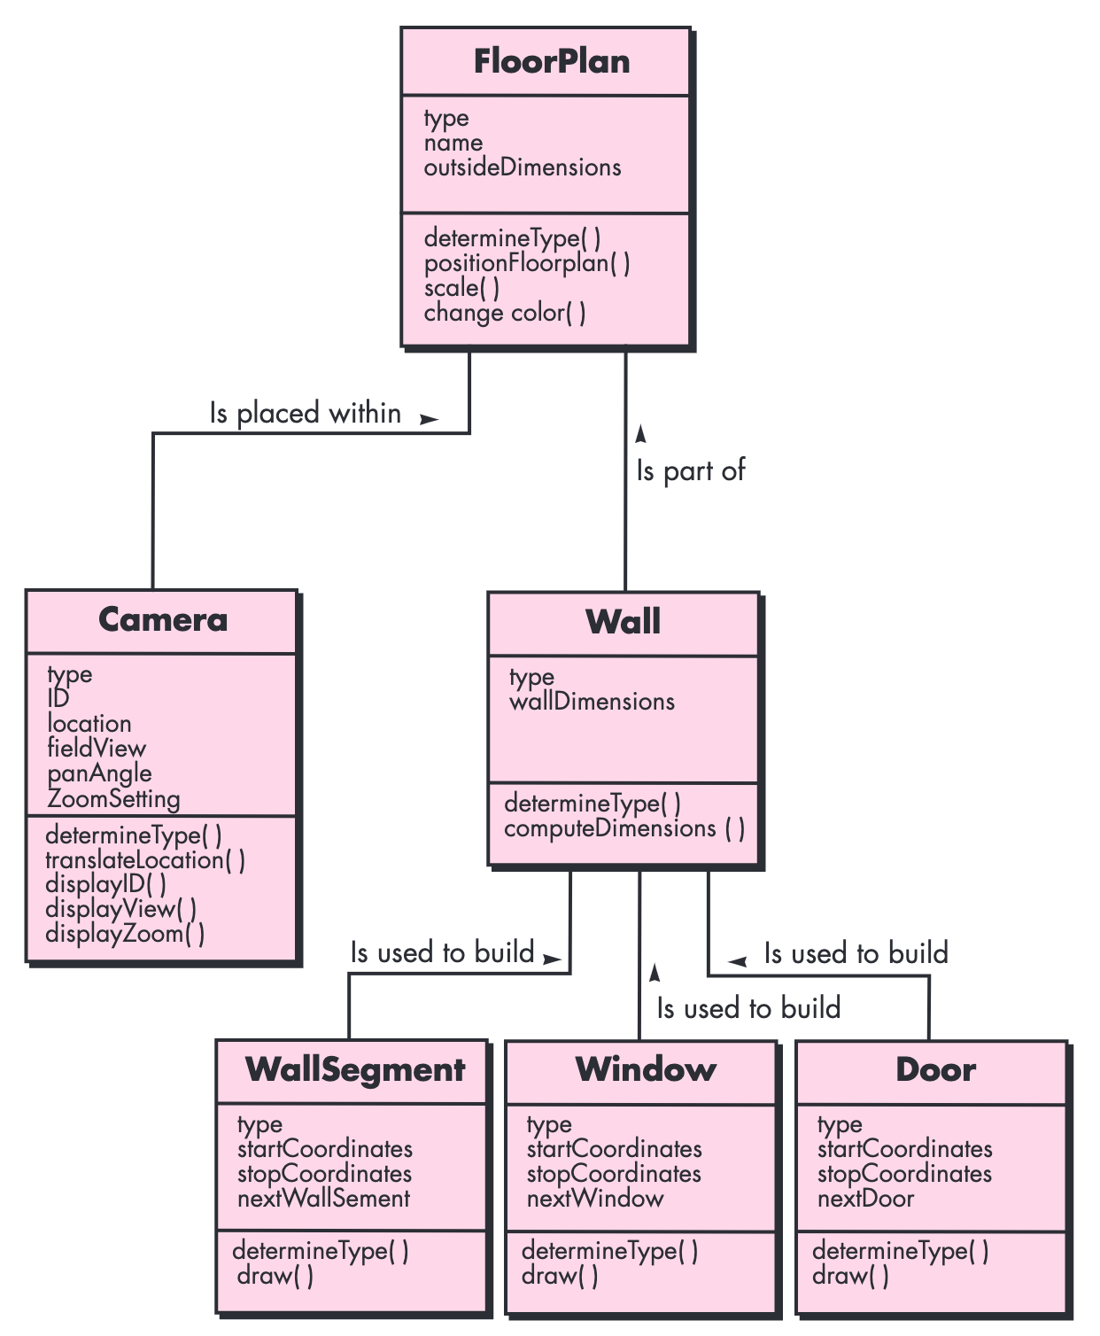
29
z
Class-based
Modelling

Slide 30
30
z
Class-based
Modelling
Associations and Dependencies
§ In many instances, two classes are related to one another in
some fashion, much like two data objects may be related to one
another.
§ In UML these relationships are called associations.

Slide 31
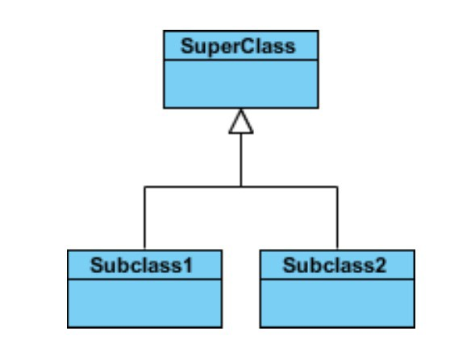
31
z
Relationships
•
Represents an "is-a"
relationship.
An abstract class name is
shown in italics.
SubClass1 and SubClass2 are
specializations of Super Class.
A solid line with a hollow
arrowhead that point from the
child to the parent class
Inheritance
(or
Generalization)
•
•
•

Slide 32
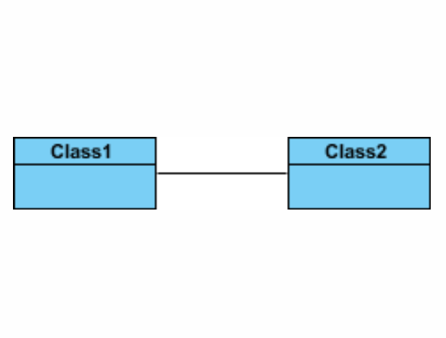
32
z
Relationships
Simple Association
• A structural link between two
peer classes.
There is an association between Class1 and Class2
• A solid line connecting two
classes

Slide 33
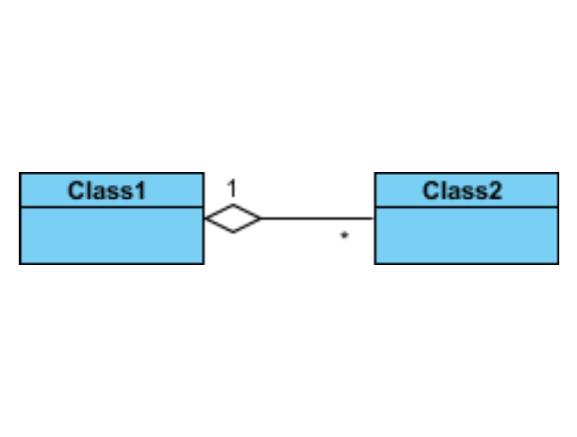
33
z
Relationships
Aggregation
§
§
A special type of association.
It represents a "part of"
relationship.
Class2 is part of Class1. Objects of Class1 and Class2
have separate lifetimes.
A solid line with an unfilled
diamond at the association end
connected to the class of
composite
•
•
•

Slide 34
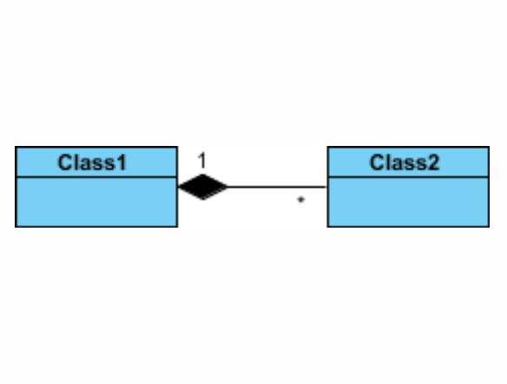
34
z
Relationships
Composition
§
A special type of aggregation
where parts are destroyed
when the whole is destroyed.
Objects of Class2 live and die
with Class1
Class2 cannot stand by itself. A solid line with a filled
diamond at the association
connected to the class of
composite
•
•
•

Slide 35
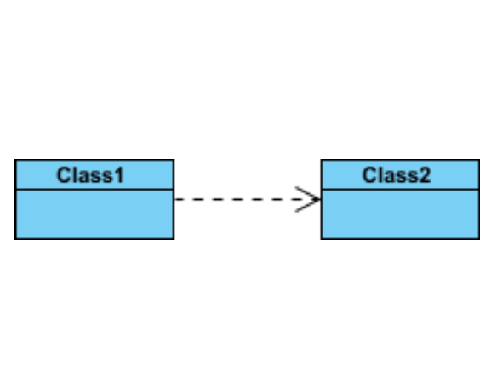
35
z
Relationships
Dependency
• Exists between two classes if
the changes to the definition
of one may cause changes
the other (but not the other way around).
to
• Class1 depends on Class2
A dashed line with an open arrow

Slide 36
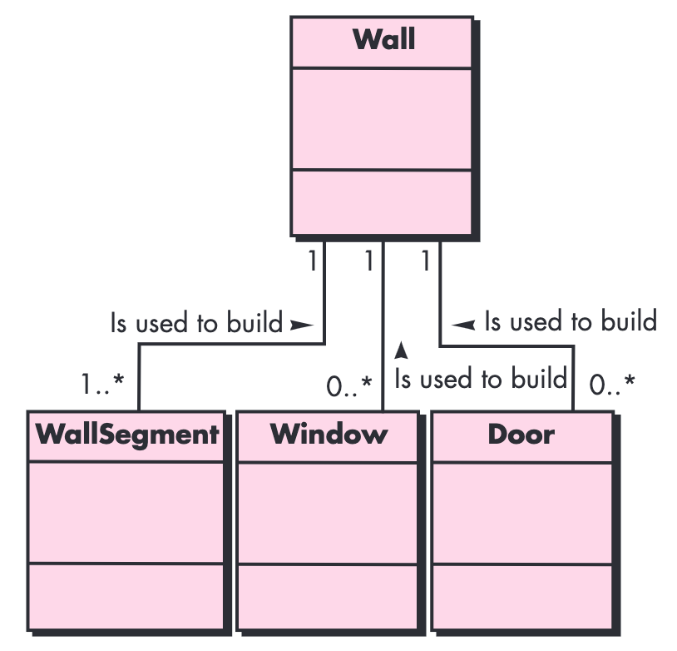
36
z
Class-based
Modelling
An association may be further defined by indicating multiplicity.
• Exactly one - 1
• Zero or one - 0..1
• Many - 0..* or *
• One or more - 1..*
• Exact Number - e.g. 3..4 or 6

Slide 37
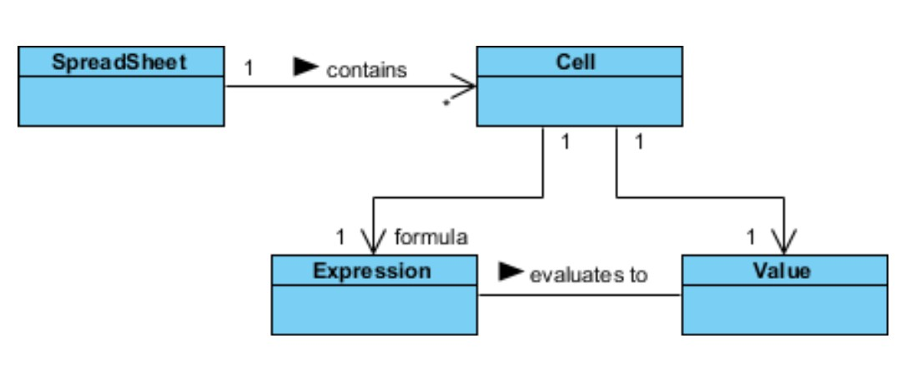
37
z
Relationship Names
§ Names of relationships are written in the middle of the association line.
§ Good relation names make sense when you read them out loud.
§ They often have a small arrowhead to show the direction in which direction to read the relationship

Slide 38
38
z
Class-Responsibility-Collaborator (CRC)
Modelling
§ Provides a simple means for identifying and organizing the
classes that are relevant to system or product requirements.
§ A collection of standard index cards that represent classes.
§ The cards are divided into three sections.
§ Along the top of the card you write the name of the class.
§ In the body of the card you list the class responsibilities on the left
and the collaborators on the right.

Slide 39
39
z
Class-Responsibility-Collaborator (CRC)
Modelling
§ Responsibilities are what the class does.
§ Collaborators are those classes that are required to provide a class with the information needed to complete a responsibility.
§ One purpose of CRC cards is to fail early, to fail often, and to fail
inexpensively. It is a lot cheaper to tear up a bunch of cards than
it would be to reorganize a large amount of source code
- C. Horstmann

Slide 40
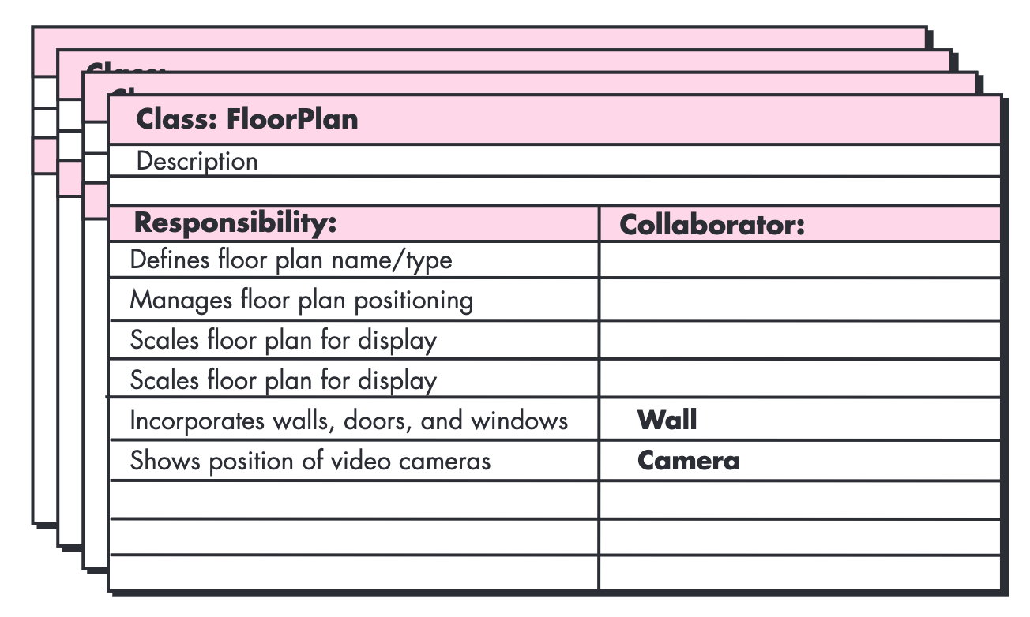
40
z
Class-Responsibility-Collaborator (CRC)
Modelling

Slide 41
41
z
Exercise
1. Develop a
2 Develop a product or
use-case diagram for some scenarios in your project
complete set of CRC model index cards on the system you chose for your project

Slide 42
42
Any Questions?
The End
z

